Slide 1
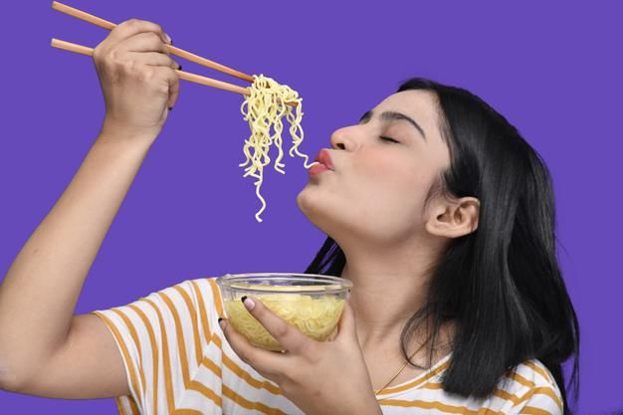
Notes:
Hello teacher and hello everyone my name is Mao Pheaktra. I am from class 2024C at PNC school.

Slide 2
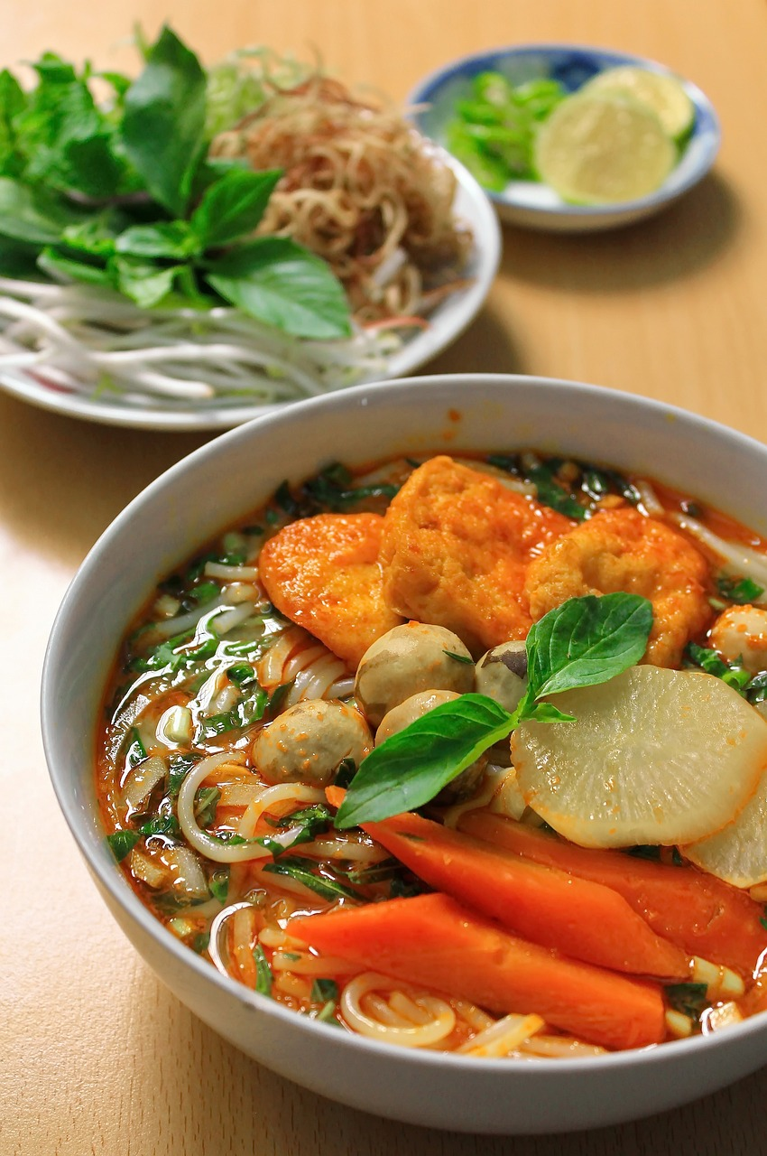
Disadvantages
of noodles

Slide 3
What is noodles?
Notes:
Instant Noodles are a popular dish because they are cheap, easy to cook and easy to buy on the street.

Slide 4


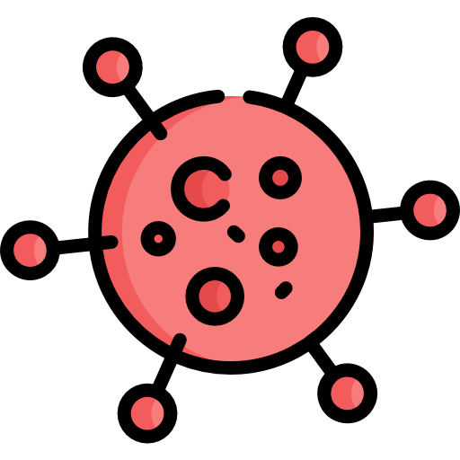
What are the health effects of eating a lot of noodles?
Heart disease
High blood
Cause cancer

Slide 5
Conclusion

Slide 6

Thank You!

